Slide 1
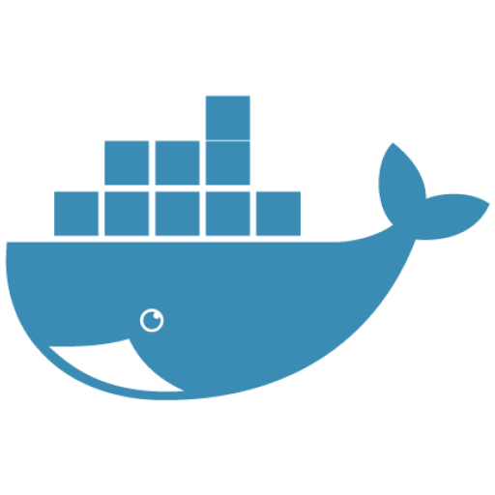
Big Picture Docker
What, Why, Who, & Features

Slide 2
What is Docker?
Docker is a platform that lets you package, develop, and run applications in containers.
A container is a virtual environment on top of the OS kernel to capture all of its software - libraries, dependencies, etc.
Container
Container
Container
Kernel

Slide 3
Why does Docker matter?
A more lightweight approach than virtual machines to isolated coding and project environments.
Portability to the major architectures and operating systems.
Helps achieve continuous integration and deployment for development operations.

Slide 4
Who Does Docker affect most?
Developers and software engineers.
Operators and devops engineers.
Startups and enterprises.

Slide 5
Main features
Create containers and images.
Docker-compose for multicontainer applications.
Docker swarm to utilize multiple machines running Docker.

Slide 6
Docker Containers and the Docker Engine

Slide 7
What is a Docker Container?
A Docker container is a loosely isolated environment running within a host machine’s kernel that allows us to run application-specific code.

Slide 8
The Kernel
The kernel is the software at the core of an operating system, with complete control.
The CPU is the core circuitry which executes program instructions.
Docker runs on top of original machine’s kernel - making it the host machine.

Slide 9

The Docker Engine
Consists of the Docker server, an API, and command line interface.
The server is also called the Docker daemon.
daemon - background processes on an operating system.
Docker daemon is like a construction team on the host machine.

Slide 10
The Docker Engine on an Operating System
Command Line - uses the Docker CLI
Requests to create containers
Container
Container
Container
Docker Daemon
Host Kernel

Slide 11
Docker Container Environments
The processes of one container cannot affect the processes of another.
A container has limits on resource usage, like the CPU and memory.
Application-specific code.

Slide 12
What is a Docker Container?
A Docker container is a loosely isolated environment running within a host machine’s kernel that allows us to run application-specific code.

Slide 13
Why are containers useful?
Portability to multiple operating system environments.
Less time setting up, more time coding.
Development, continuous integration, deployment environments.

Slide 14
Containers vs. Virtual Machines
Virtual machines abstract an entire computer system.
Run a 2GB image of software
Virtual Machines
Require 2GB to run the image
Containers
Use 2GB to run the image.
5VMs x 2GB = 10GB
2G + 0.001G*N^{n} Containers

Slide 15
Docker Images

Slide 16


Docker Images
are “ready-only templates with instructions for creating a Docker container.”
define the container code, libraries, environment variables, configuration files, and more.

Slide 17
Dockerfile
Outlines instructions for how an image will create a container.

Slide 18
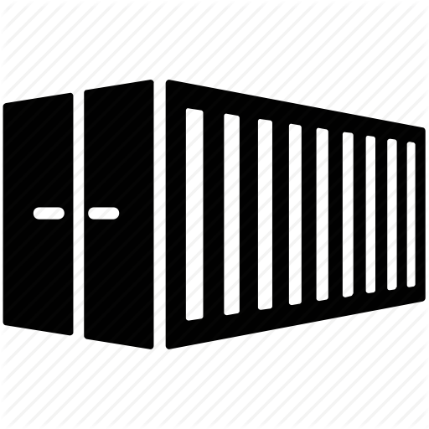


Image to Container Relationship
Image
Running
Container

Slide 19
Dockerhub
Collects images from Docker users and hosts them as online repositories.

Slide 20
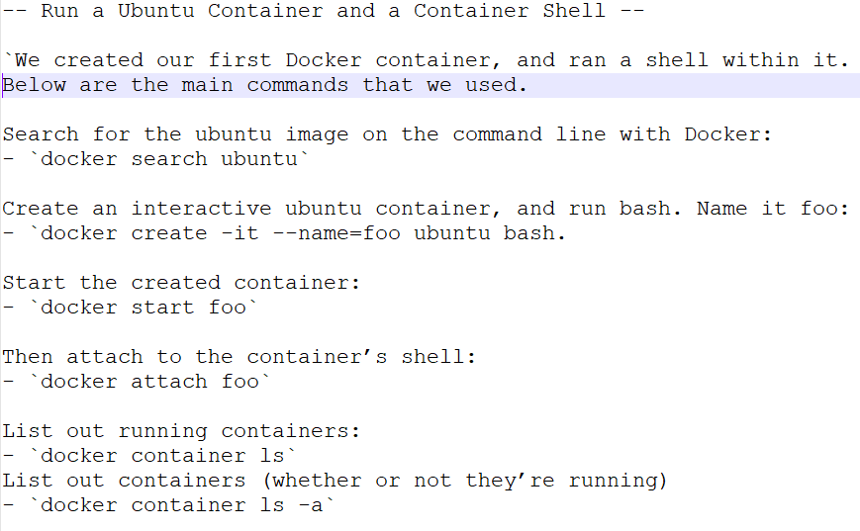

Slide 21
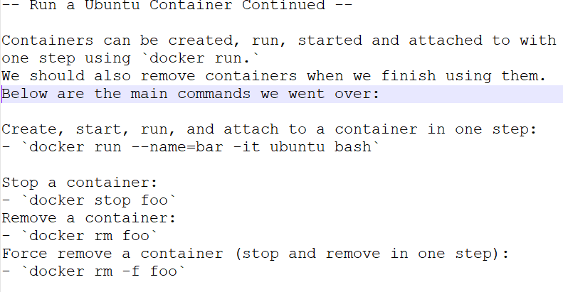

Slide 22
Docker Containers and Images | Summary and Commands
Docker Containers and Images | Summary and Commands
Nice work on completing the first section of this course on Docker containers and images. In this section, we learned plenty of important concepts.
We got a grasp of how Docker works, from the running docker engine, the creation of docker images, and the execution of running containers themselves. We learned about the great engineering benefit of isolated environments through containers. Plus we also got a taste of some of the great engineering ideas of Docker, such as caching previous images to optimize performance, and sharing common files across containers.
Moving on, we’ll explore Docker images more deeply. We’ll create our own customized container images, and dive into more advanced features.
In the meantime, here’s a summary of the commands we’ve used thus far:
Docker Containers and Images
Docker Containers
Create an interactive terminal container with a name, an image, and a default command:
Usage: docker create -it --name=<name> <image> <command>
Example: docker create -it --name=foo ubuntu bash
List all running containers:
docker container ls
(list all containers, running or not): docker container ls -a

Slide 23
Start a docker container:
Usage: docker start <container name or id>
Example: docker start foo
Attach to a docker container:
Usage: docker attach <container name or id>
Example: docker attach foo
Remove a container:
Usage: docker rm <container name or id>
Example: docker rm foo
Force remove: docker rm foo -f
Run a new container:
Usage: docker run <image> <command>
Example with options: docker run --name=bar -it ubuntu bash
Remove all containers:
docker container ls -aq | xargs docker container rm
Docker Images
Remove all images:
docker image ls -aq | xargs docker rmi -f
Search for a docker image:
Usage: docker search <image>
Example: docker search ubuntu

Slide 24
Docker Images and the Dockerfile

Slide 25
Docker Images
A “ready-only template with instructions for creating a Docker container.”

Slide 26
Dockerfile
A text document with various commands that assemble to build a container.
$ docker create image... → FROM
$ docker create image command → CMD
COPY, RUN, and more...

Slide 27
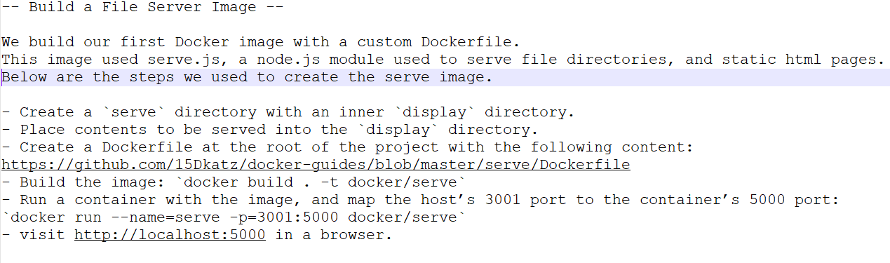

Slide 28
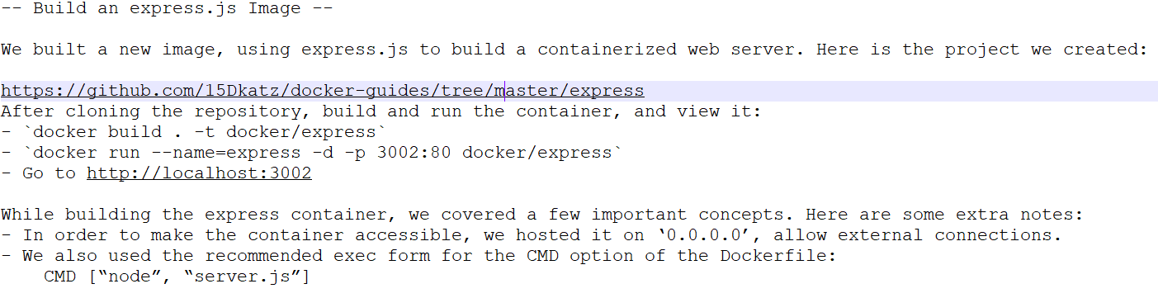

Slide 29
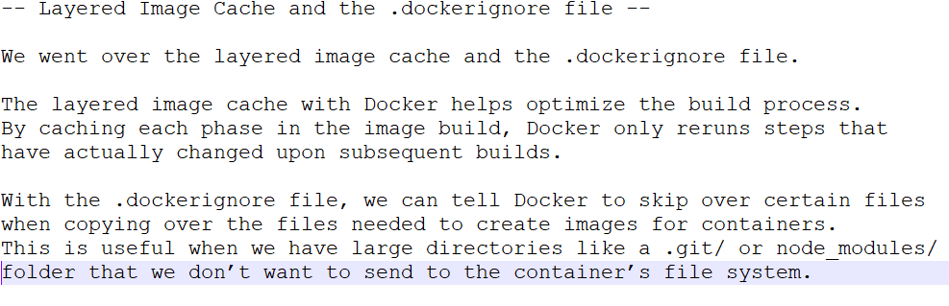

Slide 30
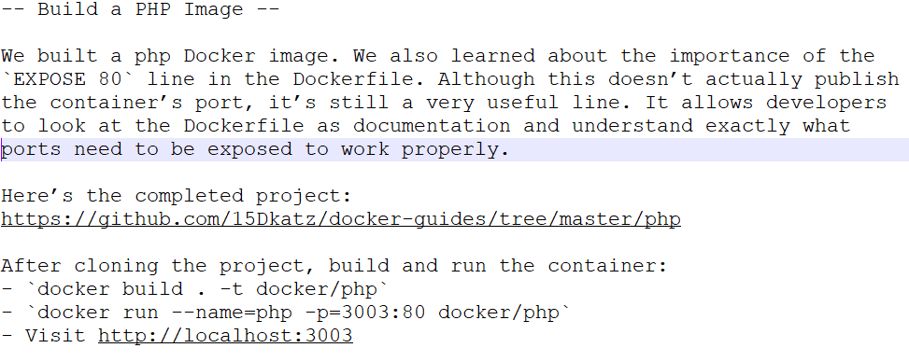

Slide 31
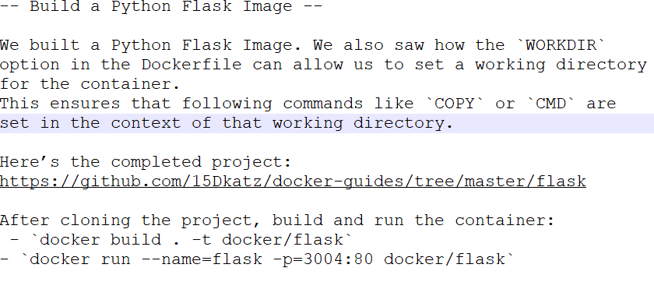

Slide 32
Docker Images in Depth | Summary and Commands
Docker Images in Depth | Summary and Commands
Excellent job on completing this section on taking a deeper dive into docker images. In this section, we learned plenty of important lessons about images.
For one, images are highly important since they provide the blueprints for docker containers. They are created by editing a customized document called the Dockerfile. Examples of dockerfiles, as well as hundreds of useful images are all stored on dockerhub - ready for us to explore.
Next, we’ll explore more advanced features of containers. Soon, we’ll even allow multiple containers to interact in order to have really complex Docker application setups.
In the meantime, here’s a collection of the Docker commands we have used thus far:

Slide 33
Docker Containers
Create an interactive terminal container with a name, an image, and a default command:
Usage: docker create -it --name=<name> <image> <command>
Example: docker create -it --name=foo ubuntu bash
List all running containers:
docker container ls
(list all containers, running or not): docker container ls -a
Start a docker container:
Usage: docker start <container name/id>
Example: docker start foo
Attach to a docker container:
Usage: docker attach <container name/id>
Example: docker attach foo
Remove a container:
Usage: docker rm <container name/id>
Example: docker rm foo
Force remove: docker rm foo -f
Run a new container:
Usage: docker run <image> <command>
Example with options: docker run --name=bar -it ubuntu bash

Slide 34
Remove all containers:
docker container ls -aq | xargs docker container rm
Execute a command in a running container:
Usage: docker exec <container name/id> <command>
Example (interactive, with tty): docker exec -it express bash
Docker Images
Remove a docker image:
Usage: docker image rmi <image id>
Example (only uses first 3 characters of image id): docker rmi 70b
Remove all images:
docker image ls -aq | xargs docker rmi -f
Search for a docker image on dockerhub:
Usage: docker search <image>
Example: docker search ubuntu
List docker images:
docker image ls
Build a Docker image:
Usage: docker build <path>
Example (also tags and names the build): docker build . -t org/serve:0.0.0

Slide 35
Dockerfiles
Specify a base image:
Usage: FROM <base image>
Example: FROM node:latest
Set a working directory for the container:
Usage: WORKDIR <dir>
Example: WORKDIR /usr/src/app
Run a command for the container image:
Usage: RUN command
Command: RUN npm install -g serve
Copy files into the container:
Usage: COPY <local files/directories> <container files/directories>
Example: COPY ./display ./display
Inform that a port should be exposed
Usage: EXPOSE <port>
Example: EXPOSE 80
Specify a default command for the container:
Usage (shell format): CMD <default command>
Example: CMD serve ./display
Usage (exec format, recommended): CMD [“default command”, “arguments”]
Example: CMD [“node”, “server.js”]

Slide 36
Docker Swarm

Slide 37
Swarm mode
A feature within Docker to maintain a cluster of machines running the Docker engine.
The swarm is the cluster itself.
Docker Engine
Docker Engine
Docker Engine
Docker Engine
Docker Engine
Docker Engine
Website

Slide 38
Swarm mode
A node “is an instance of the Docker engine participating in the swarm.”
Nodes will have a manager or worker role.
A service runs software in the swarm based off of an image.
A replica takes the image software and clones it onto nodes.
A task is an instance of a Docker container running in a node.

Slide 39
Why Docker Swarm?
Extreme ability to scale.
Highly reliable.
Great features: load balancing, service discovery, and more.

Slide 40
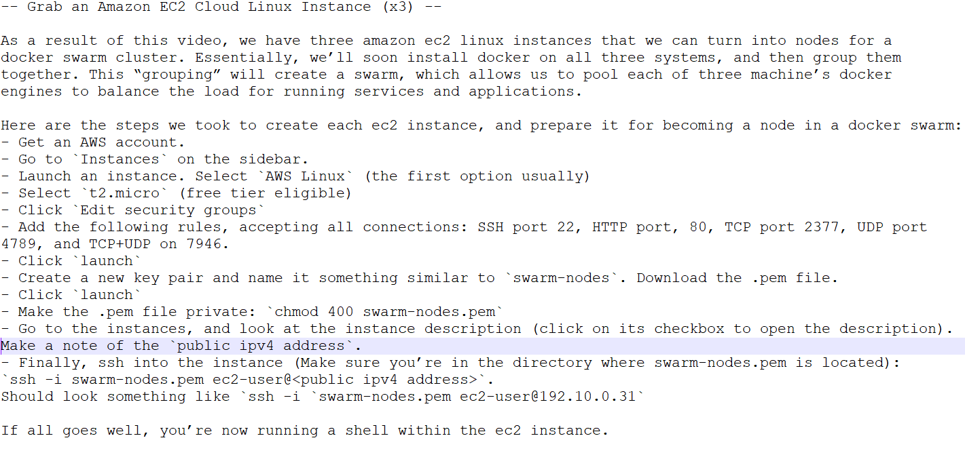

Slide 41
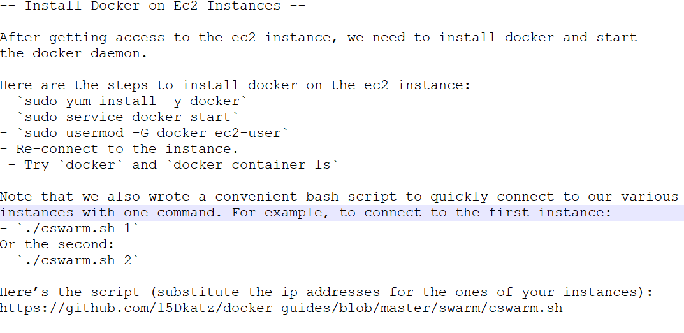

Slide 42
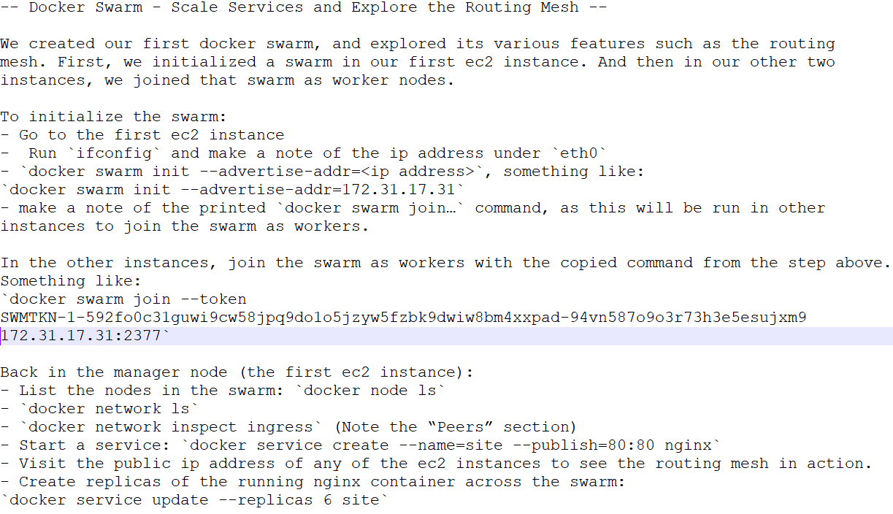

Slide 43
Docker Swarm | Summary and Commands
Great work on completing this section on Docker Swarm. In this section, we went over quite a few important concepts.
For one, we explored docker swarm and learned how having more than one machine running docker can really help engineering efforts. With docker swarm, we have a system for extreme scalability and reliability. Not to mention, we great benefits such as the swarm routing mesh, and load balancing between nodes (docker hosts connected to the swarm).
NOTE: Be sure to terminate your amazon ec2 instances once you’re done with them. Even if it’s less than a dollar, you probably don’t want charges going to your credit card for unused instances. You can terminate the instances by updating their instance state with the “Actions” dropdown in the management console.
Finally, here’s the summary of commands that we’ve used so far. Head to the bottom of the summary to see new notes on Docker swarm.

Slide 44
Docker Containers
Create an interactive terminal container with a name, an image, and a default command:
Usage: docker create -it --name=<name> <image> <command>
Example: docker create -it --name=foo ubuntu bash
List all running containers:
docker container ls
(list all containers, running or not): docker container ls -a
Start a docker container:
Usage: docker start <container name/id>
Example: docker start foo
Attach to a docker container:
Usage: docker attach <container name/id>
Example: docker attach foo
Remove a container:
Usage: docker rm <container name/id>
Example: docker rm foo
Force remove: docker rm foo -f

Slide 45
Run a new container:
Usage: docker run <image> <command>
Example with options: docker run --name=bar -it ubuntu bash
Remove all containers:
docker container ls -aq | xargs docker container rm
Execute a command in a running container:
Usage: docker exec <container name/id> <command>
Example (interactive, with tty): docker exec -it express bash
Docker Images
Remove a docker image:
Usage: docker image rmi <image id>
Example (only uses first 3 characters of image id): docker rmi 70b
Remove all images:
docker image ls -aq | xargs docker rmi -f
Search for a docker image on dockerhub:
Usage: docker search <image>
Example: docker search ubuntu
List docker images:
docker image ls
Build a Docker image:
Usage: docker build <path>
Example (also tags and names the build): docker build . -t org/serve:0.0.0

Slide 46
Dockerfiles
Specify a base image:
Usage: FROM <base image>
Example: FROM node:latest
Set a working directory for the container:
Usage: WORKDIR <dir>
Example: WORKDIR /usr/src/app
Run a command for the container image:
Usage: RUN command
Command: RUN npm install -g serve
Copy files into the container:
Usage: COPY <local files/directories> <container files/directories>
Example: COPY ./display ./display
Inform that a port should be exposed
Usage: EXPOSE <port>
Example: EXPOSE 80
Specify a default command for the container:
Usage (shell format): CMD <default command>
Example: CMD serve ./display
Usage (exec format, recommended): CMD [“default command”, “arguments”]
Example: CMD [“node”, “server.js”]

Slide 47
ross-Container Storage
Volumes
Create a volume
Usage: docker volume create <volume name>
Example: docker volume create shared-vol
Inspect a volume
Usage: docker volume inspect <volume name>
Example: docker volume inspect shared-vol
Mount a container with a volume using docker run
Usage: --mount source=<volume name>, target=<container dir>
Example:
docker run -it --name=foo --mount source=shared-vol,target=/src/shared ubuntu bash
Bind Mounts
Mount a container with a bind mount using docker run
Usage: --mount type=bind source=<host dir>, target=<container dir>
Example:
docker run -it --name=foo --mount type=bind source=/Users/foo/bindmountdir, \
target=/src/mountdir ubuntu bash
Tmpfs mounts
Mount a container with a tmpfs mount using docker run
Usage: --mount type=tmpfs, destination=<container dir>
Example: docker run -it --name=baz --mount type=tmpfs, destination=/tmpdir ubuntu bash

Slide 48
Docker Networking
List docker networks
docker network ls
Inspect a docker network
Usage: docker network inspect <network name>
Example: docker network inspect bridge
Create a docker network
Usage: docker network create <network name>
Example: docker network create privatenw
Run a container with a custom docker network:
Usage: --network=<network name>
Example: docker run --network=privatenw -it --name=goo busybox
Docker Compose
Start a compose application
At the root (where docker-compose.yml is located): docker-compose up
Start a compose application and rebuild images:
Docker-compose up --build
docker-compose.yml
Version
Current version is 3. So at the top of the file, specify: version: ‘3’
Services with builds
Have a services key in the file. List out services one indent at a time.

Slide 49
Dependencies
Use the depends_on key and specify dependencies with a list. Each container dependency is marked by a dash, such as: -backend
Volumes
Have a volume key per service.
Connect a Docker host directory to a container directory, by joining them with a colon.
Example: ./dockerhostdir:/containerdir
Networks
Declare networks at the bottom of the file.
Specify each service’s network(s) with the networks option for each service.
Docker Swarm
Initialize a swarm in a node
Usage: docker swarm init --advertise-addr=<node ip>
Example: docker swarm init --advertise-addr=172.31.17.31
After initializing the swarm, you will find a join command for worker/other manager nodes
Example: docker swarm join --token SWMTKN-1-592fo0c31guwi9cw58jpaw89fafzyw5fzbk9dwiw8bm4xxpad-94vn587o9o3r73h3e5esujxm9 172.31.17.31:2377
List docker nodes from a manger:
docker node ls
Create a service for the swarm:
Usage: docker service create --name=<service name> --publish=<host port:service port> <service image>
Example: docker service create --name=site --publish=80:80 nginx

Slide 50
List services:
docker service ls
List the running tasks for a service:
Usage: docker service ps <service name>
Example: docker service ps site
Update a service
Usage: docker service update [options] <service name>
Example: docker service update --replicas=6 site

